Slide 1
IS 120
JavaScript APIs Continued

Slide 2
Announcements
Project 3 due Saturday
  Requirements are in the class repo
  Will be very similar to what we do today
What day works best for end of semester interviews?

Slide 3


Slide 4
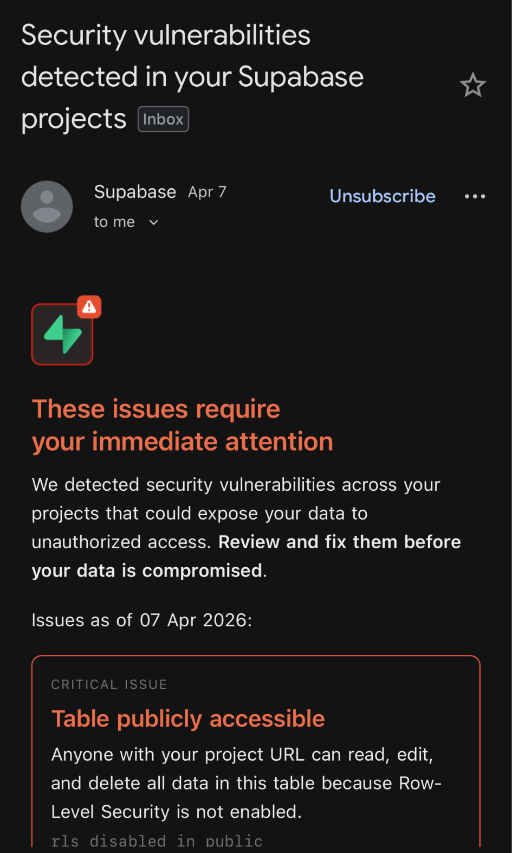
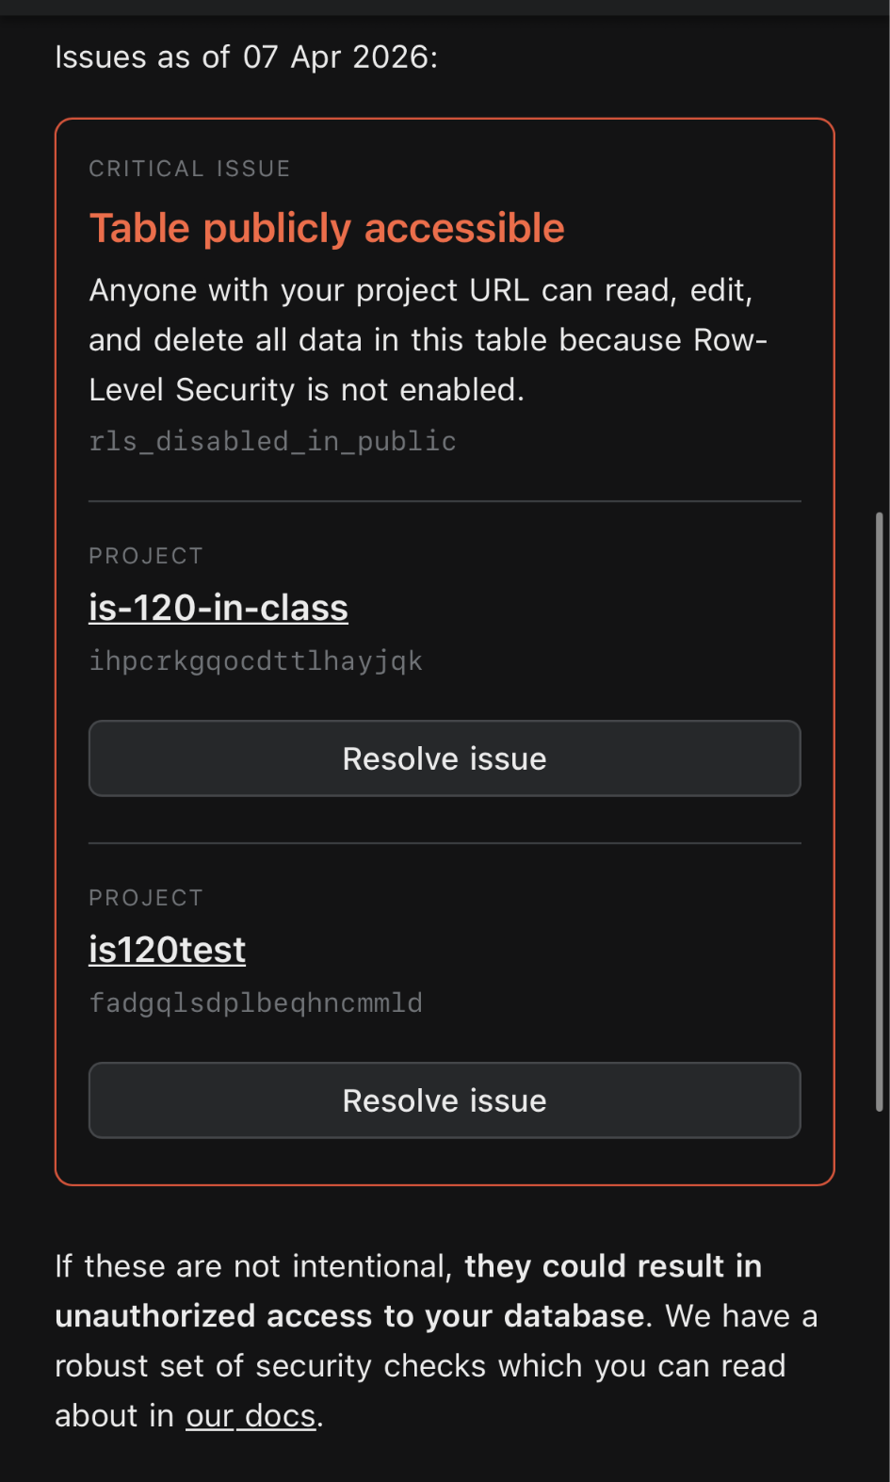

Slide 5
CRUD
Create
Read
Update
Delete

Slide 6
CRUD
Create -> insert, add, save, submit
Read -> select, get
Update -> edit, change
Delete -> remove

Slide 7
HTTP Requests
You have already used these a ton! We just haven’t talked about what they are
HyperText Transfer Protocol (HTTP)
↑ Look familiar?

Slide 8
HTTP Requests
You have already used these a ton! We just haven’t talked about what they are
HyperText Transfer Protocol (HTTP)
Can send HTML pages, JSON for APIs, and lots of other things

Slide 9
HTTP Requests
URL -> http://example.com (HTTPS means it’s secure)
Header -> Contains authentication and type of data
Body -> Actual content sent to the endpoint (usually JSON) Not all HTTP requests use a body.
Response -> Sends back a status code and data (usually JSON)
200 OK, 404 Not Found, 401 Unauthorized, 500 Server Error

Slide 10
HTTP Request Types
GET -> Read
https://google.com https://api.github.com/users/tmanatkin
POST -> Create (we will be writing a POST request later)
PUT -> Update
DELETE -> Delete

Slide 11
Pair Programming
Create functions for each Supabase operation
  Read all rows
  Create new row
  Delete row by ID
  Edit row by ID

Slide 12
Pair Programming (part 2)
For each function, tie it to an action from the DOM
What actions/elements could we tie each operation to?
  Get all
  Edit
  Delete
  Create

Slide 13
AI APIs
We’re going to use Vercel AI Gateway
Allows us to pick different models instead of being locked down to a single provider (OpenAI, Anthropic, Google, etc.)
I am going to give you my PRIVATE API KEY
So please be careful and don’t charge me $100

Slide 14
AI API Demo

Slide 15
Last Day of Class

